Slide 1
Charity Foundation (for CSE 402 at 29-01-2023)
Moriom Akter Chowdhury(180103020028)
Humayra Shirin Mony(190103020008)
Nusrat Jahan Amy (190103020064)
(Supervisor: Al Mehdi Saadat Chowdhury)

Slide 2
Previous Work
CSE-400

Slide 3
Humayra Shirin Mony
Completed Works
Registration/Login
Orphan record
Old age home record
Provide food and shelter for orphan

Slide 4
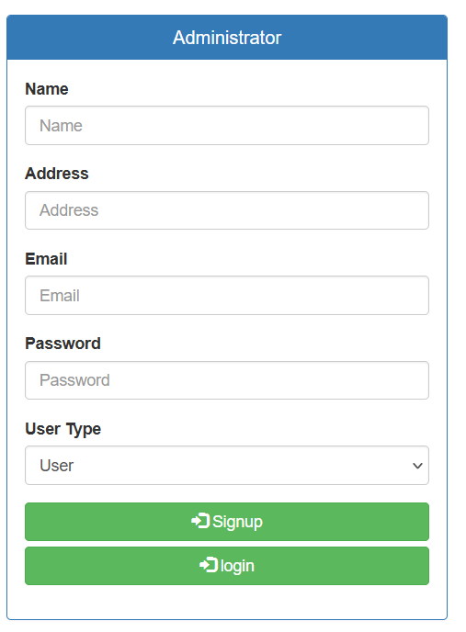
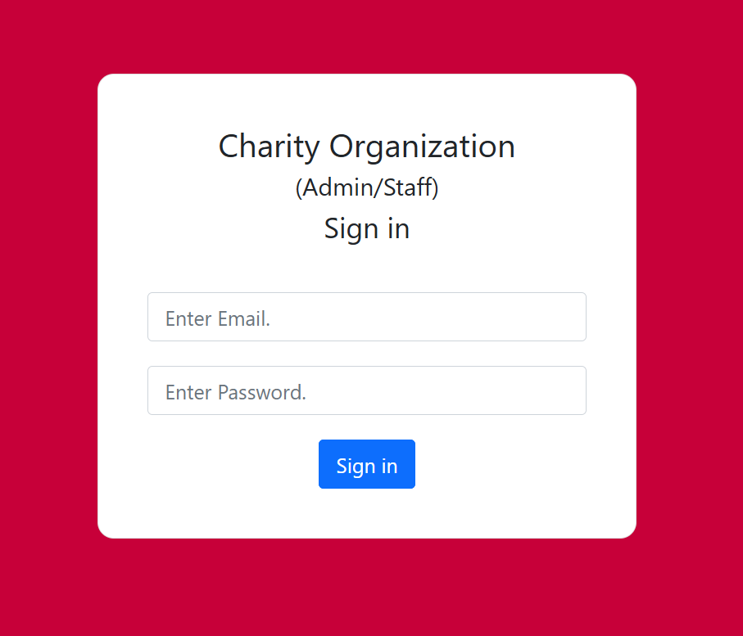
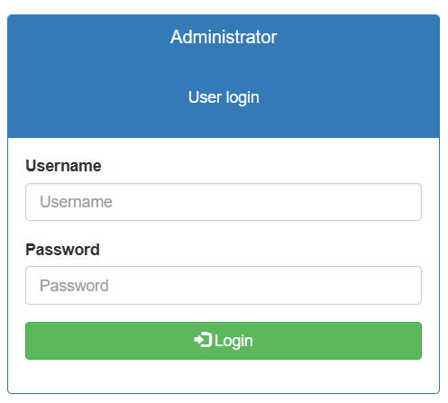
Registration/Login Unregistered users can register. Registered users can login through the login page
User Registration
Admin Login
User Login

Slide 5
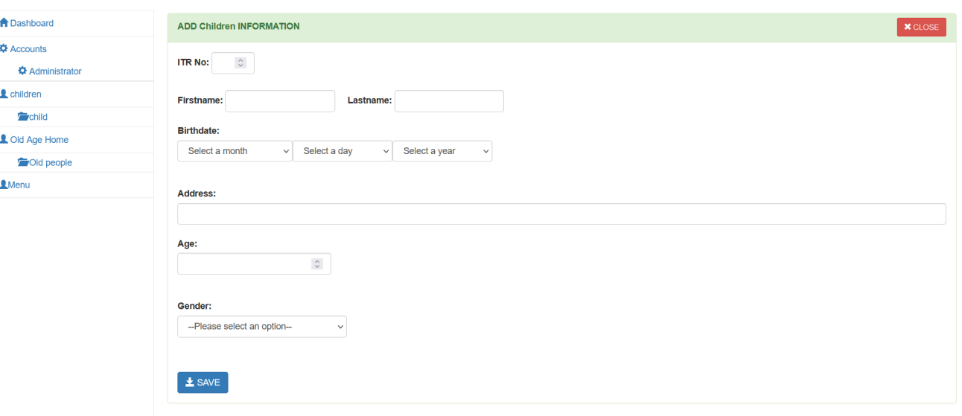
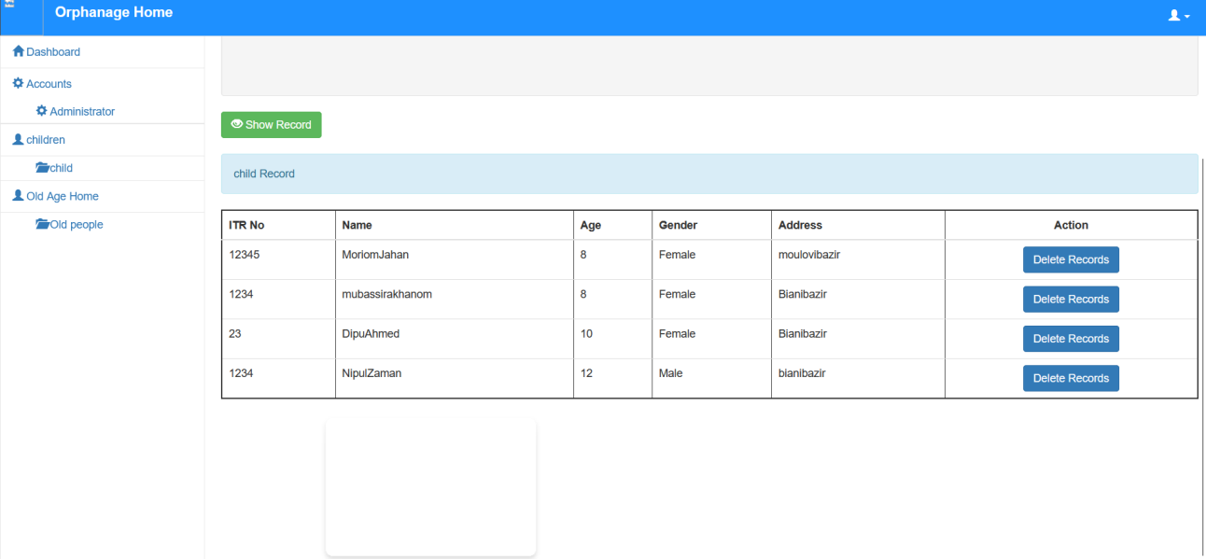
Orphan record Managers record orphans based on their name, gender, age, date they arrived
Add Orphan record
Orphan Information Displayed

Slide 6
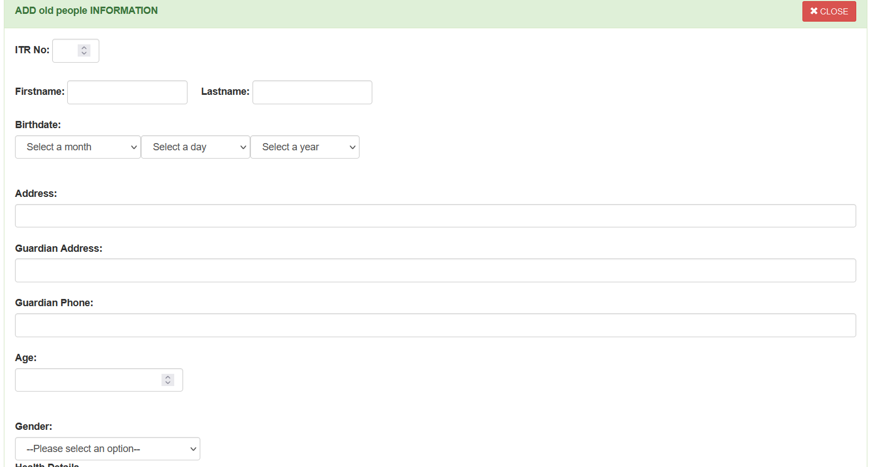
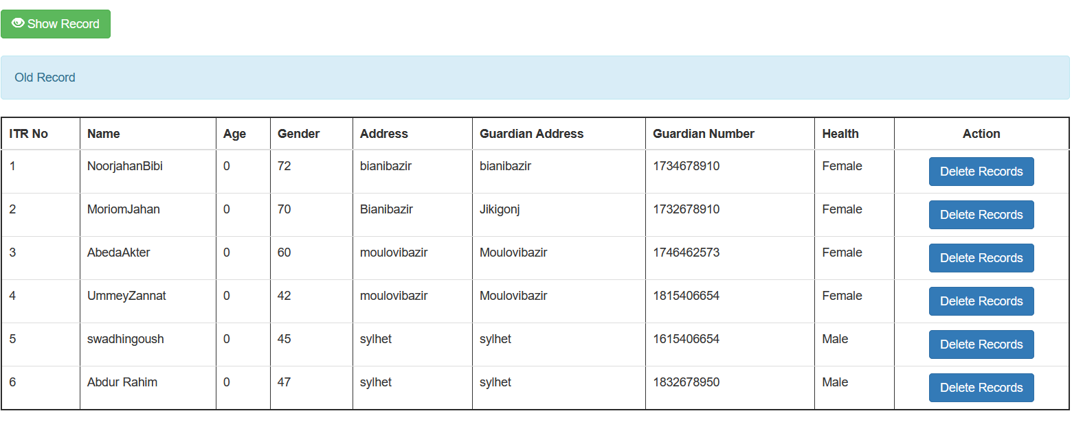
Old age home record Managers record Old age resident members information along with their medical report
Collect Information
Old age home record

Slide 7
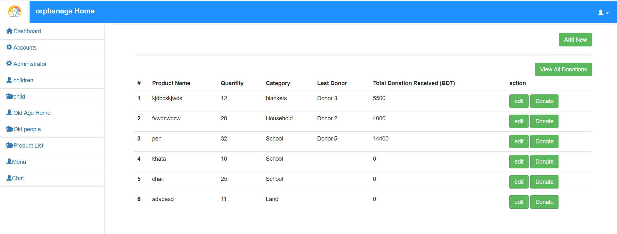
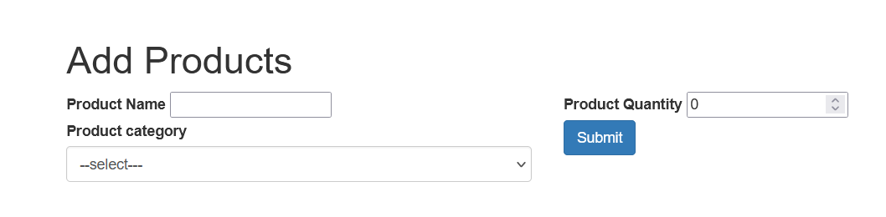
Provide food and shelter for orphan Admin can make list, edit any requirement for orphanage needs, admin can view specific product donor
Product List
Add Product

Slide 8
Nusrat Jahan Amy
Completed Works
Blood donation service
Medicine donation service
Hospital facilities service
Admin dashboard

Slide 9
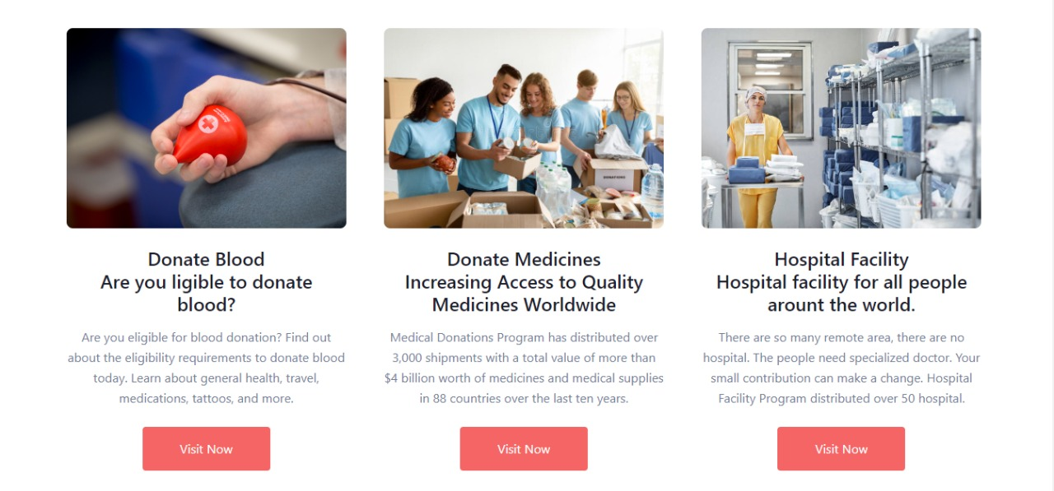
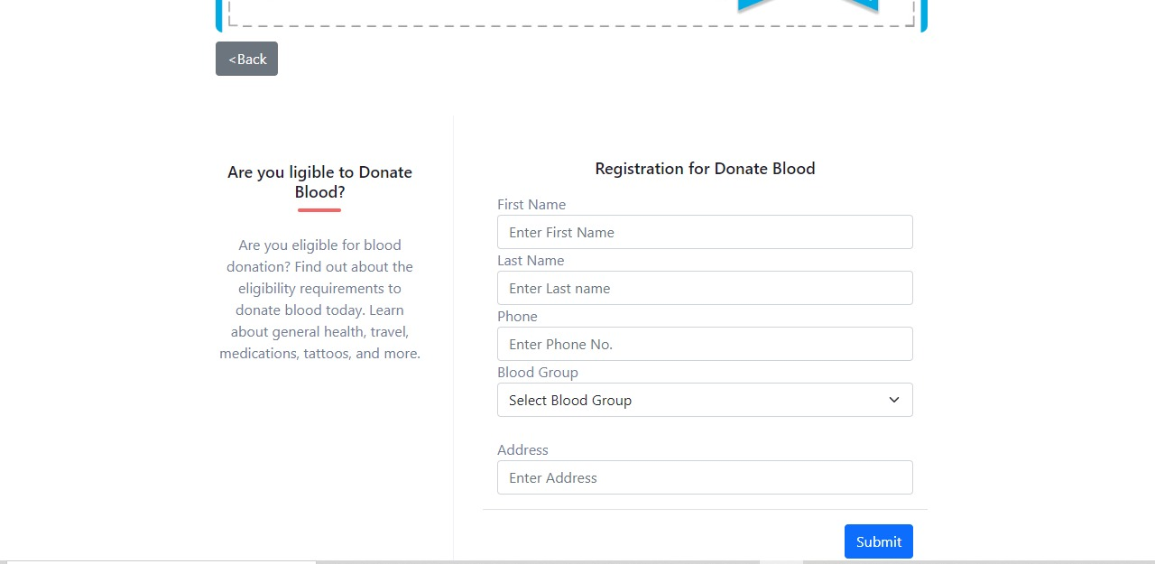
Blood donation service User can visit and donate blood for orphan
Blood donate homepage
Registration for Donate Blood

Slide 10

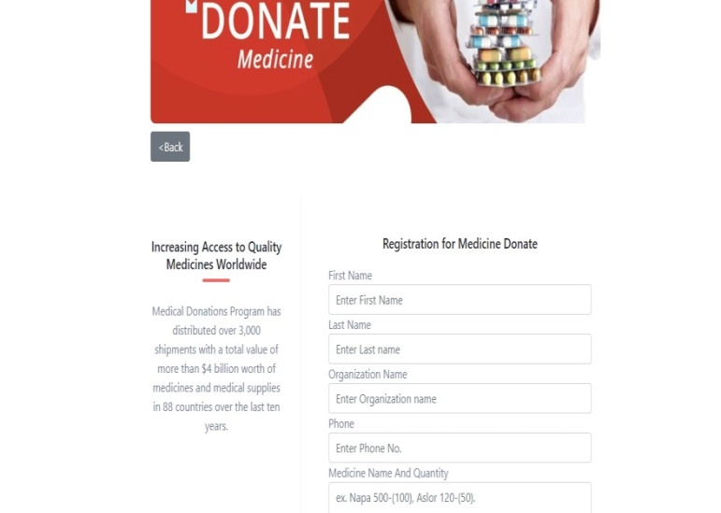
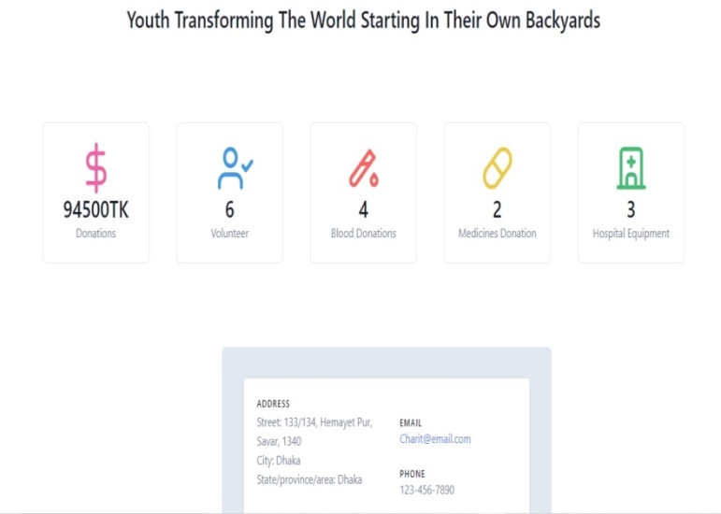
Medicine donation service User can visit medicines donate page for donate medicines.
Medicines donate homepage
Registration for Medicines Donate
Admin page

Slide 11

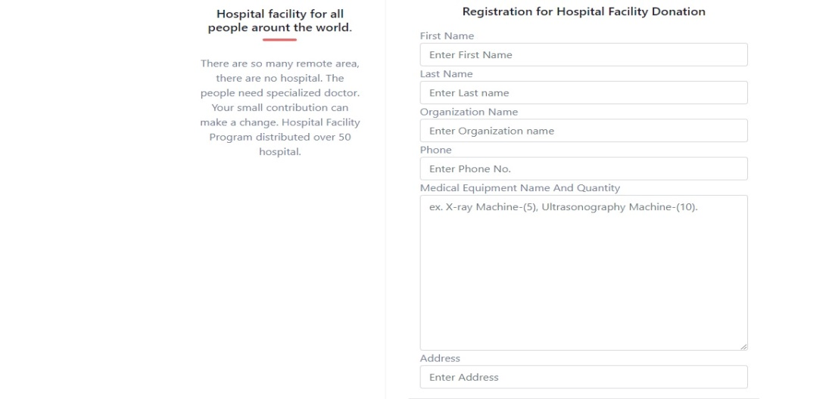

Hospital facilities service User can visit hospital facility donate page, donate hospital facility then fill-up registration page
Hospital Facility donate homepage
Registration for Hospital Facility Donation
Admin page

Slide 12
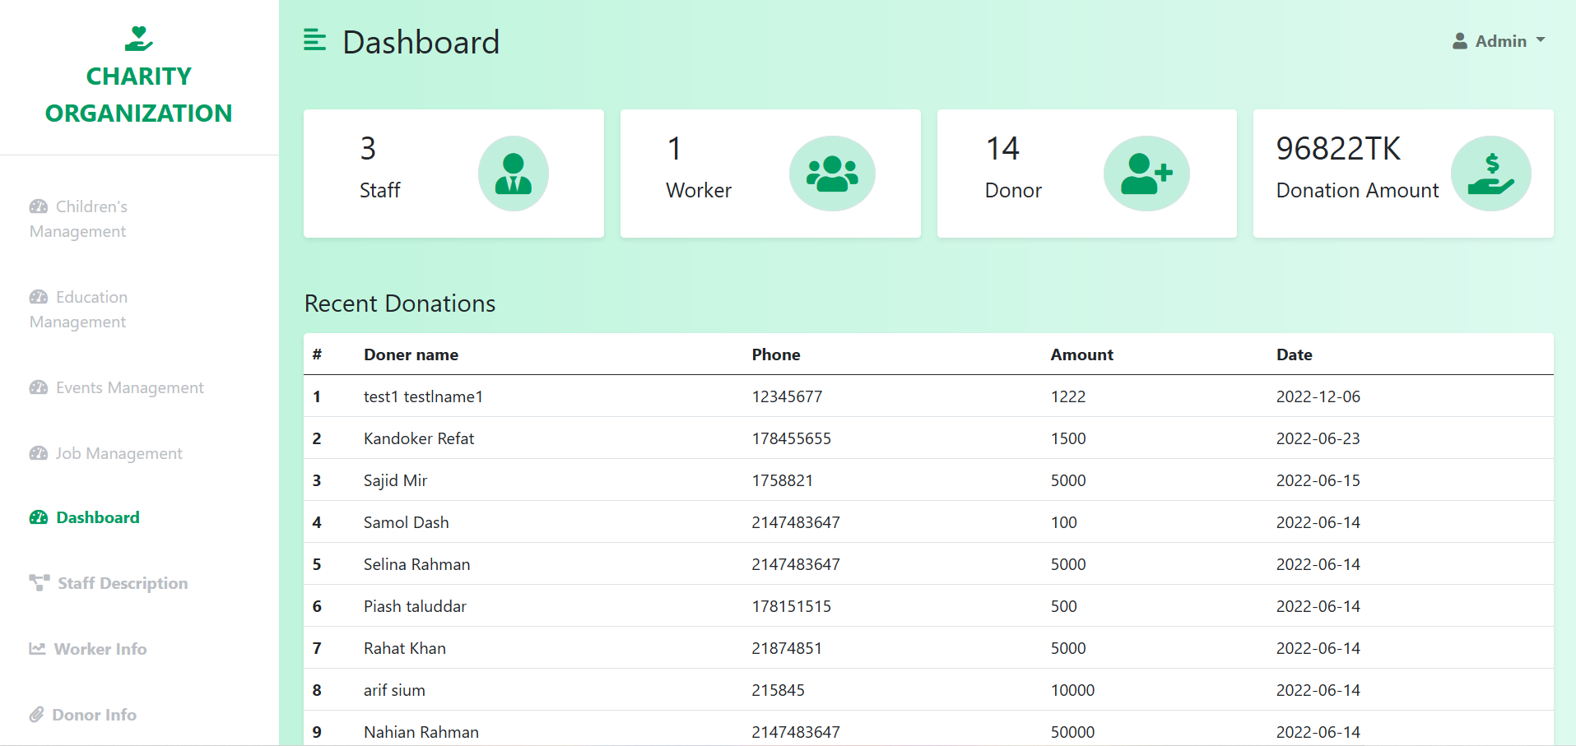
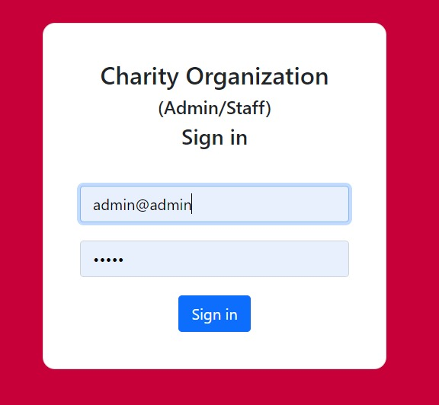
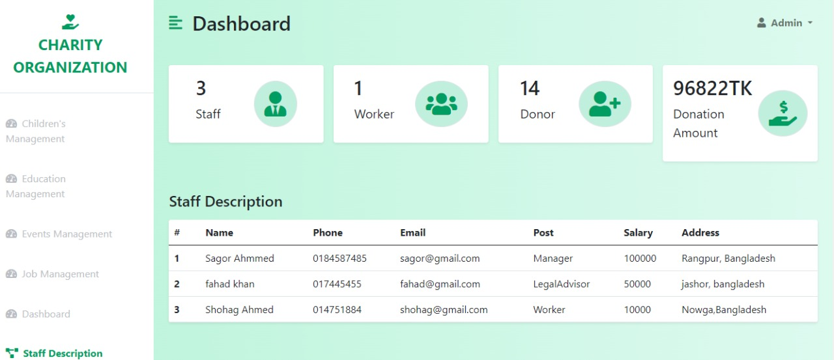
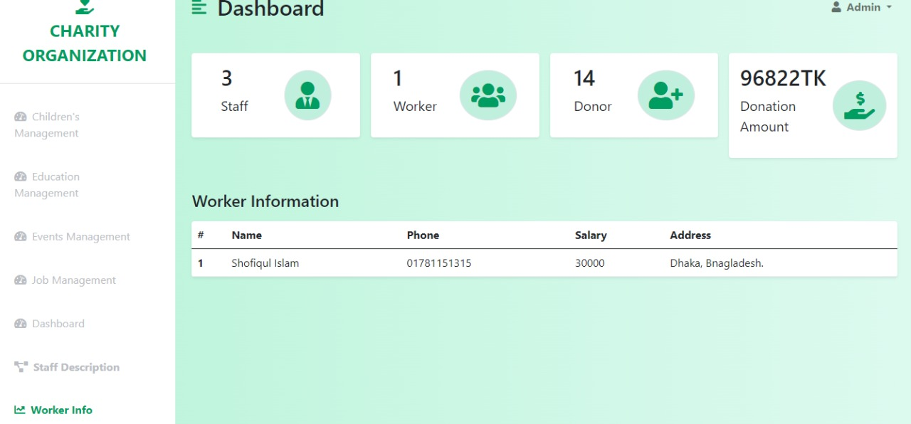
Admin Dashboard This is the admin landing page. Here Admin has recordings of staff description, worker’s information, and visitations, all details about the organization, sign in further dashboard page, view worker information, view staff details.
Admin Dashboard
Admin Sign in page
Staff Description
Worker Information

Slide 13
Moriom Akter Chowdhury
Completed Works
Landing page
Blog
Event Organization

Slide 14
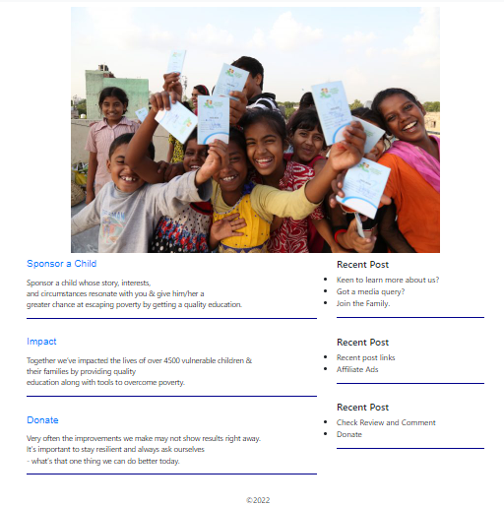
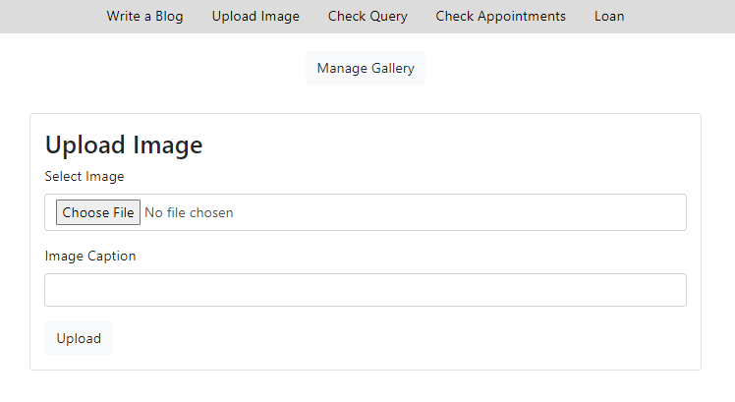
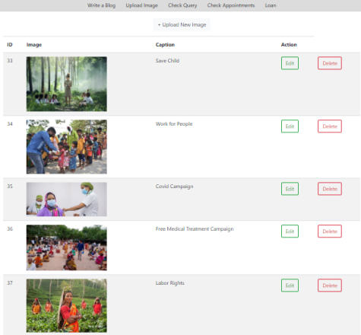
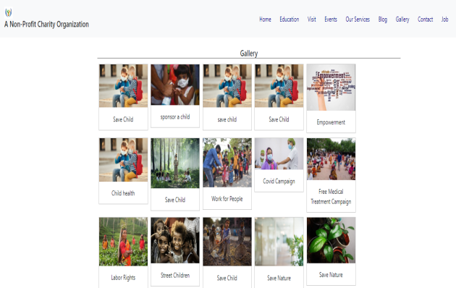
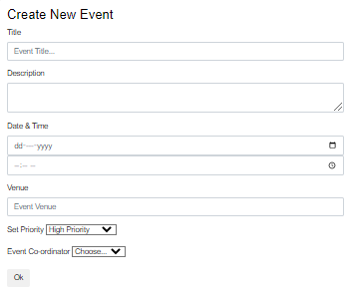
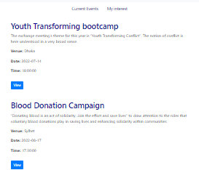
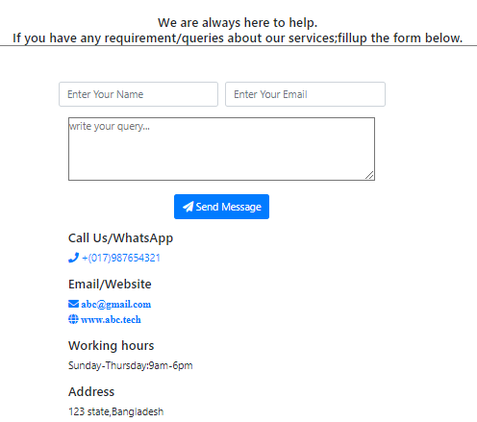
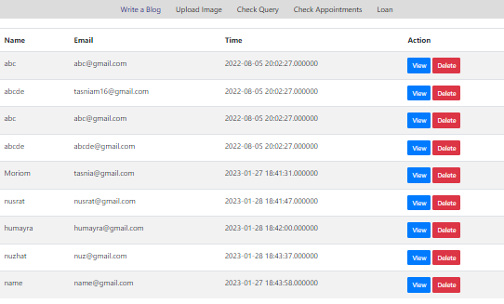
Landing Page Consists of several subsections- blog page, gallery, event, contact page.
Home Page
Admin Upload Image
Admin Manage Image
User Image View
Create Event
User Event View
Contact
Admin Check Message

Slide 15
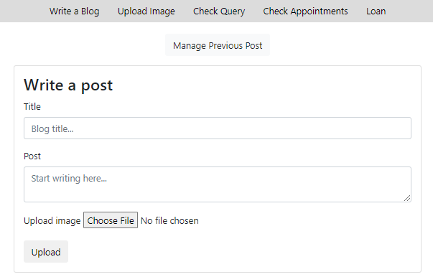
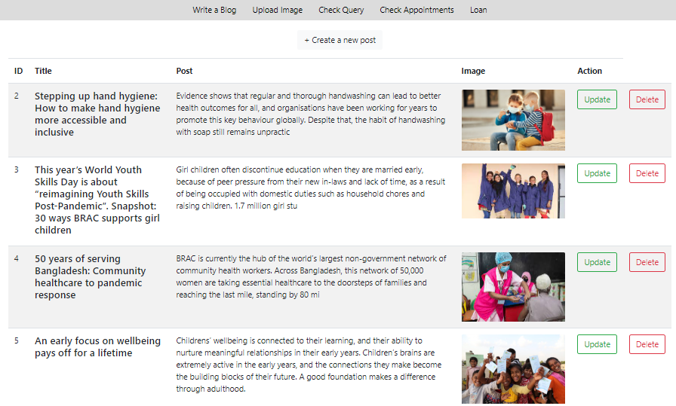
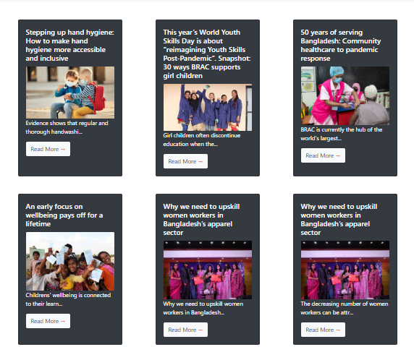
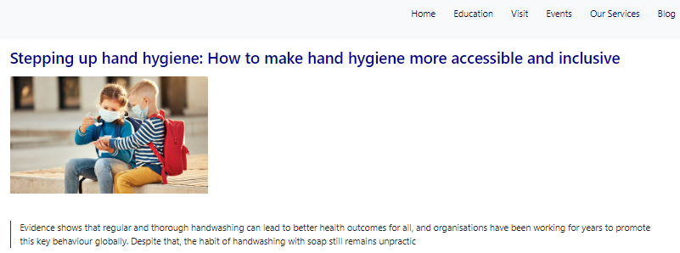
Blog Section Admin will create and manage post in blog section, user will view those.
Create Post
Read , Update , Delete Post
User View

Slide 16
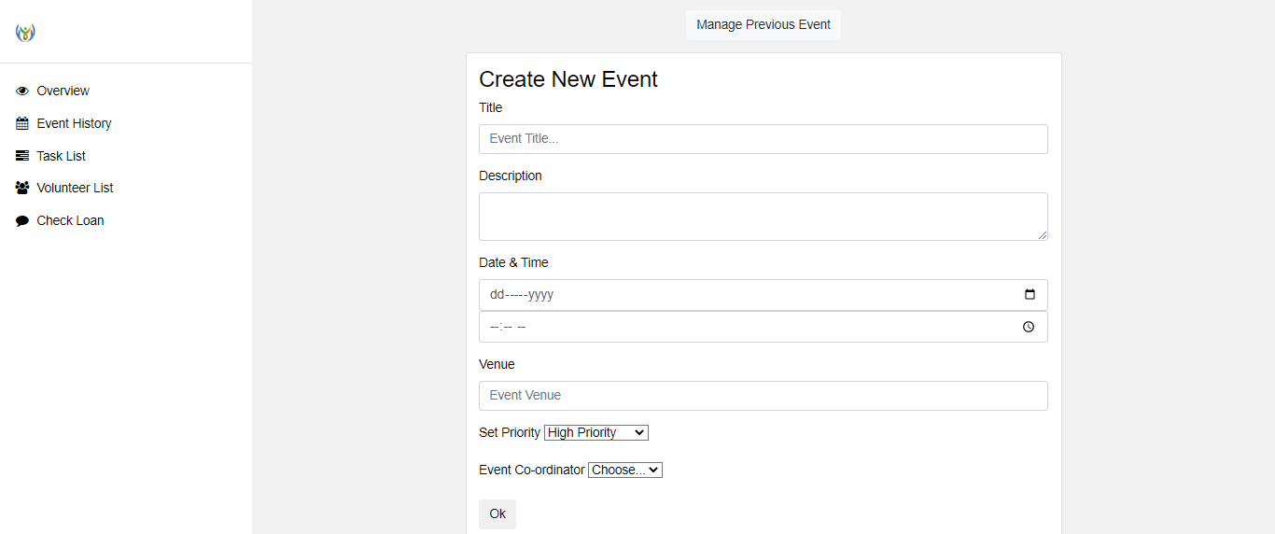
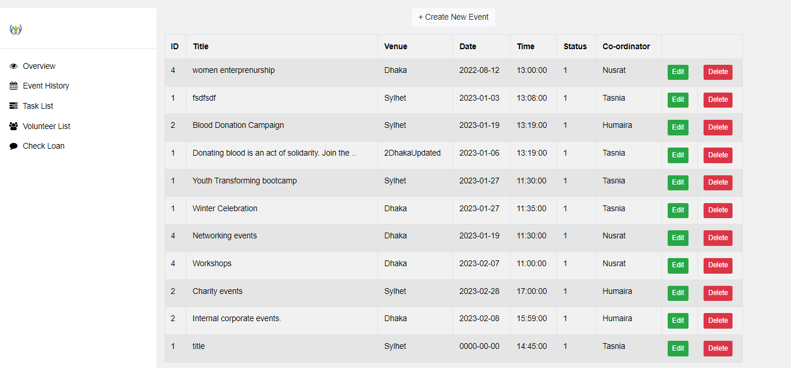
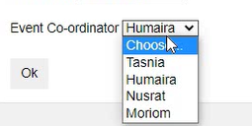
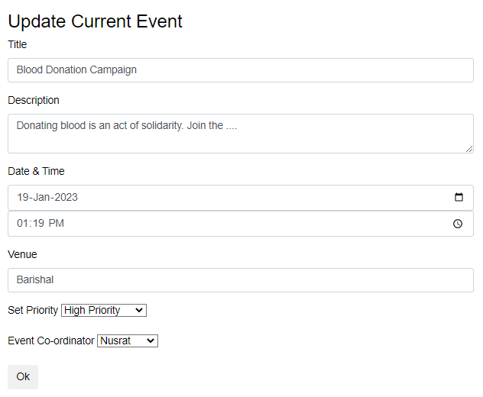
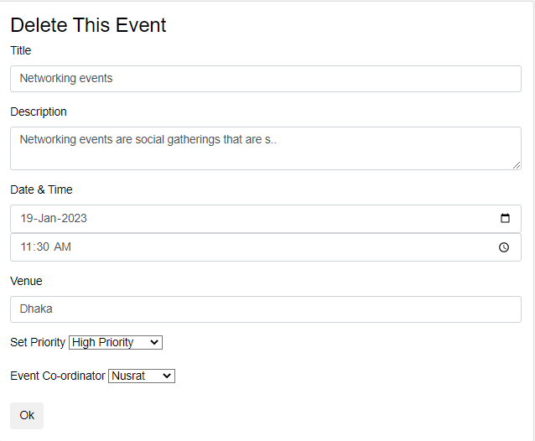
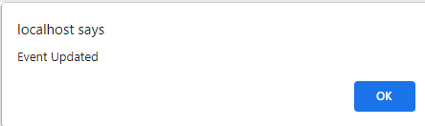
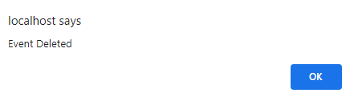
Event Organization Manager can create, update, delete an event and assign a coordinator to manage those event.
Create New Event
Assign coordinator
View Event List
Update Event
Delete Event

Slide 17
Recent Work
CSE-402

Slide 18
Humayra Shirin Mony
Completed Works
Product donation and manage product record
Chat box
Create job post
Job applying
Child sponsorship

Slide 19
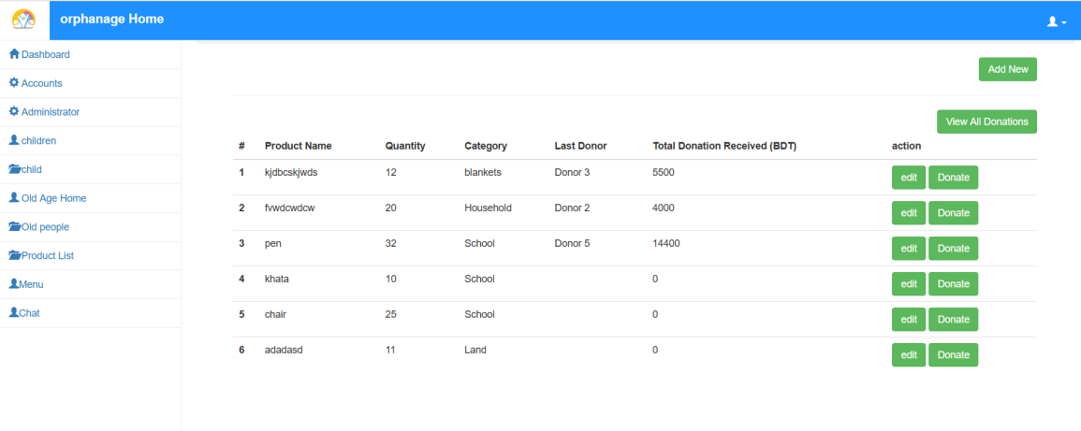
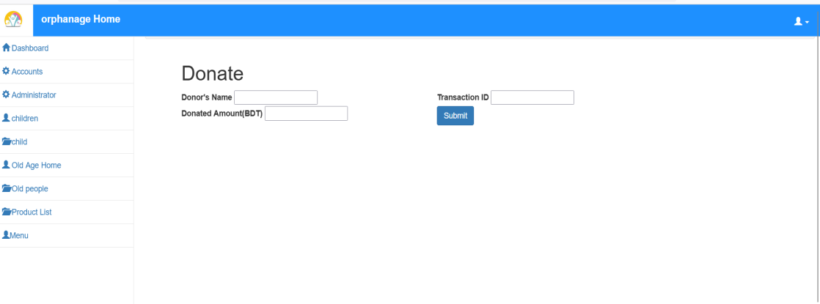
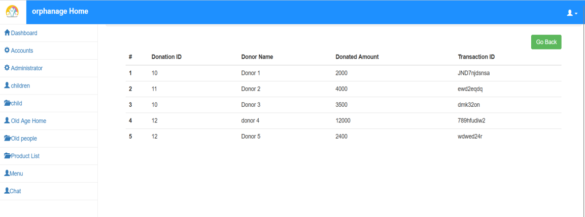
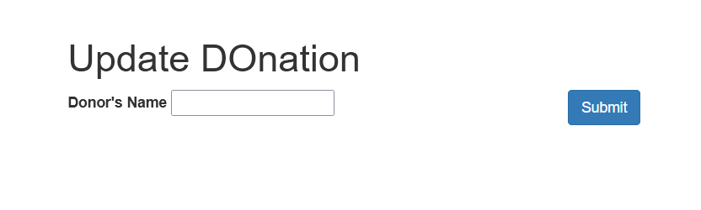
Product donation and manage product record Donor will be able to donate and record will be stored here
Product Budget List
Donor Info
Donor list
Edit Donor Name

Slide 20
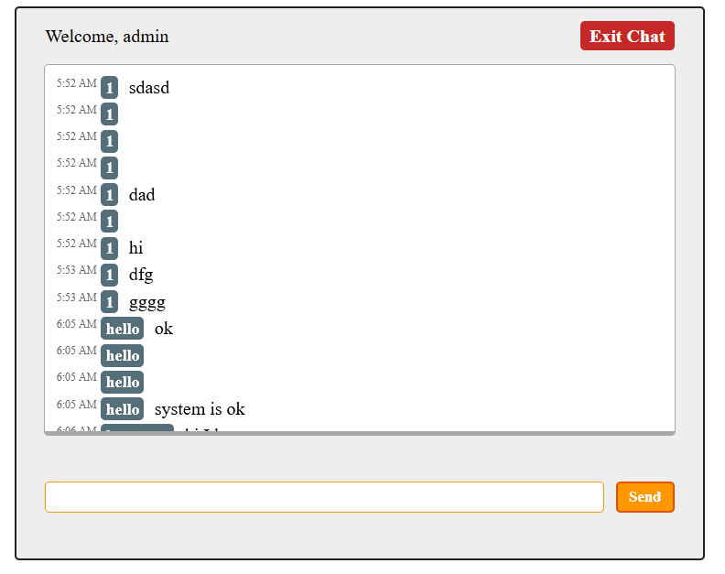
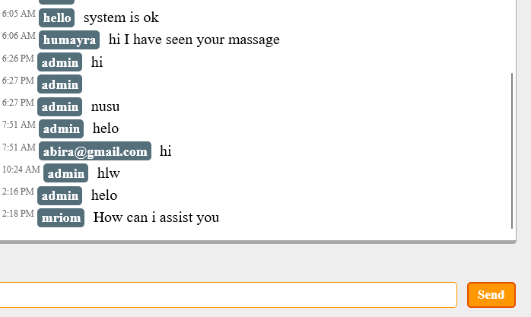
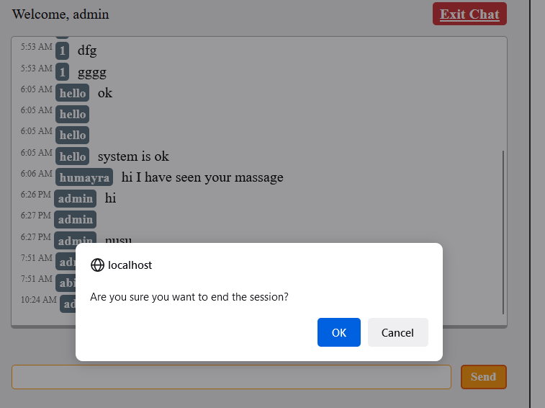
Chat box Admin can chat only admin staff, manager, volunteer, legal advisor.
Chat box
Admin & staff conversation
Exit chat

Slide 21
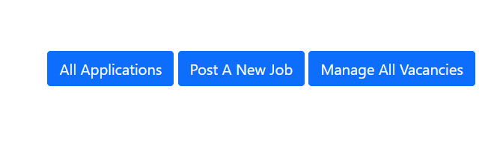
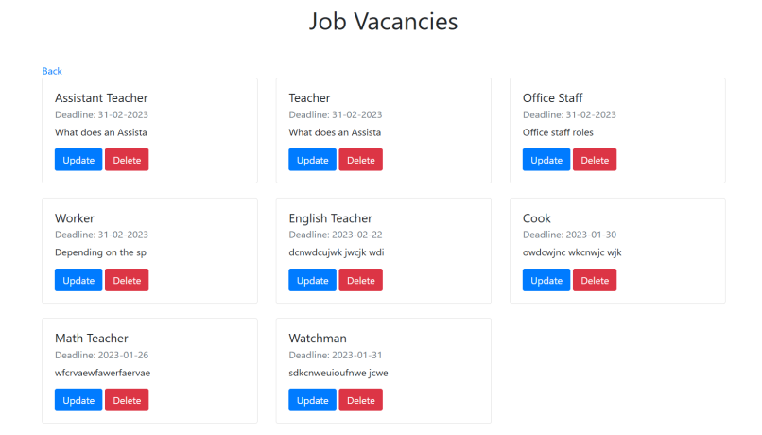
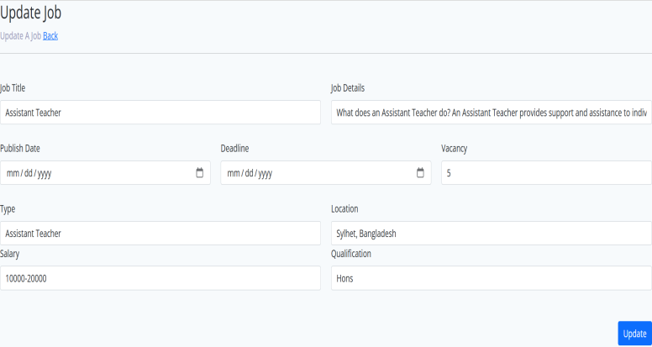
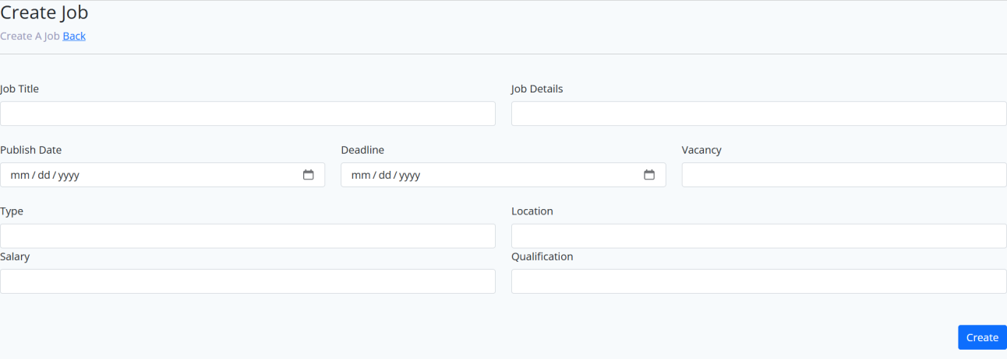
Create job post Admin will create job post according to vacancy, manage application, view applicant details
Admin Header
Job Vacancy
Job details
Add Job

Slide 22
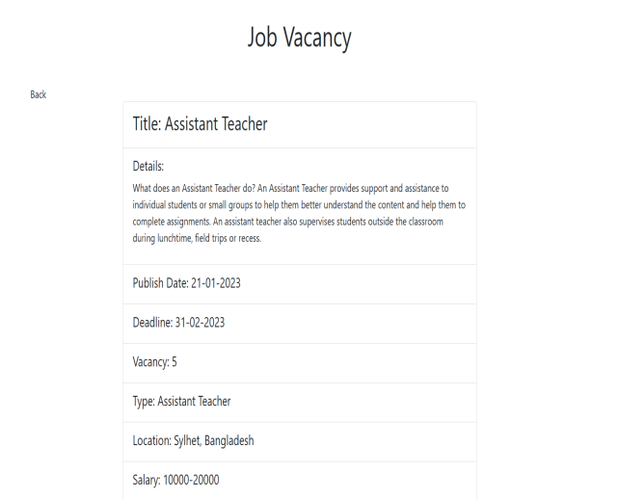
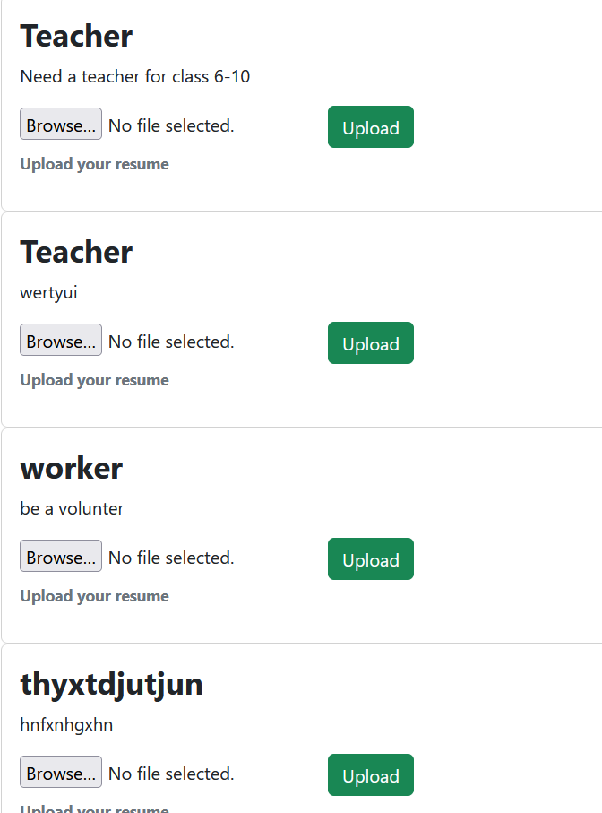




Job applying User can check jobs details, apply, upload cv in drop box. Admin can check cv, accept or reject.
User header
Uploading File
User job Vacancies
CV Details & CV Drop box
Admin Check or reject CV

Slide 23





Child sponsorship Admin can add child information, their requirement list, donation and sponsor list. Here people sponsor for children. Admin can view detail of sponsor list.
Add Child Information
Children details
Children needed list
Individual Child Sponsor List
All Child Sponsor List

Slide 24
Nusrat Jahan Amy
Completed Works
Child adoption
Visitors appointment
Orphanage expense tracking
Donation tracking
Provide orphan education

Slide 25






Child adoption Admin can sign in and user can view this page. User can adopted a child then fill up all legal information, admin can view and accept/reject adoption request, view details information
Adoption a child homepage
Adoption information page
Adoption Request Dashboard
Adoption Request
User Check Adoption Request

Slide 26




Visitors appointment User can visit then fill-up appointment form, Admin can view user visitor page
Visitor homepage
Visitor Appointment Form
Visitor Request Page
Visitor Information

Slide 27




Orphanage expense tracking The manager should track expenses at the orphanage centre, and should have a requisition form of items required by the Orphanage centre.
Sign in
Capital & Expenses
Request Of Orphan Item

Slide 28





Donation Tracking Admin has tracked all expenses and records of donations
Donation homepage
Donation Form
Donation Successful
Donor Information page
Expanse record page

Slide 29




Provide orphan education Student class information, edit information ,class routine, attendance
Homepage
Edit Class Info
Class details

Slide 30



Provide orphan education Student class information, edit information ,class routine, attendance
All Classes Routine
Class Routine
Edit Routine

Slide 31



Provide orphan education Student class information, edit information ,class routine, attendance.
Class Attendance
Class Attendance
Donate for Children Education

Slide 32
Moriom Akter Chowdhury
Completed Works
Event Management
Join as Volunteer
Search Bar
Loan Management
Payment Gateway

Slide 33








Event Management Assigned coordinator will be able to share event information with user. Create a volunteer team, budgeting for the event.
Coordinator Login
Displayed Assigned Task
Assigning Volunteer Team
Budgeting for Event
Share Event Information
Event Information User View

Slide 34


Join as Volunteer User can send request to work as volunteer in an event and event coordinator can accept/reject his request
User can Send Request
Accept/Reject Request

Slide 35



Search bar Here user can search for required information.
Output for valid Input
Search information
No result found for Invalid Input

Slide 36




Loan Management Collect information about client. Share this Information with manager . Manager can accept/reject loan request, disburse and collect loan from approved client.
Collect Client Information
View Collected Information
Loan Disbursement
Disbursement History

Slide 37




Loan Management Collect information about client. Share this Information with manager, disburse and collect loan from approved client. Manager can accept/reject loan request.
Request accept/delete
Shared Information with manager
Collect Loan
Collection History

Slide 38


Payment System Transection will be through this payment system
Enter Payable Amount
Transaction Processing

Slide 39
END of Presentation

